Slide 1
Zakat Third Pillar of Islam

Slide 3
Poor people

Slide 4
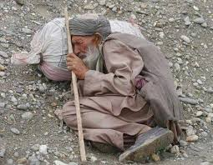
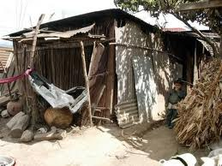
Poor people

Slide 5
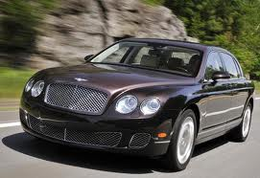
Rich people

Slide 6
Give

Slide 7
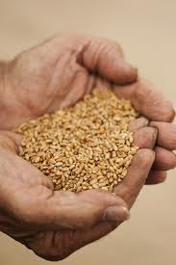
Gold and Crops

Slide 8
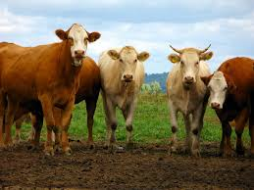
Houses and Cattle

Slide 9
Rich give to the Poor

Slide 10
Allah ordains in the Quran

Slide 11
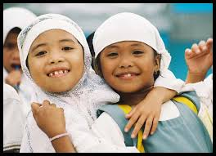
Everyone is happy

Slide 12
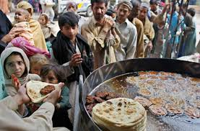
Feed the poor

Slide 13
Wealth is purified and it grows

